Slide 1
Jacek Wallusch _________________________________ Statistics for International Business
Lecture 5:
Measure of Location – Exercises

Slide 2
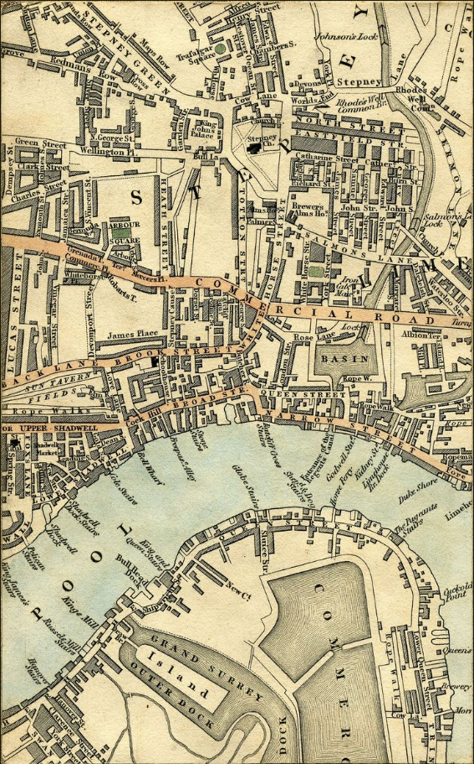
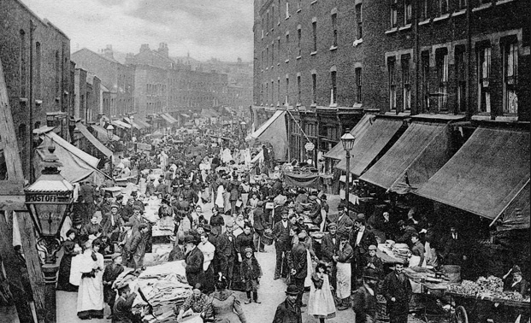
The Charming 19.Century ____________________________________________________________________________________________
median rate
Central and South-East Electricity Commission, chaired by Cecil Knightly MP, wished the Basin Slum and Shadwell to be emptied and re-purposed for a new power-station.
Statistics: 5
Dynamite and a Woman, Ripper Street
Notes:
Probability distribution and uncertainty and risk – this topic will be reconsidered soon

Slide 3
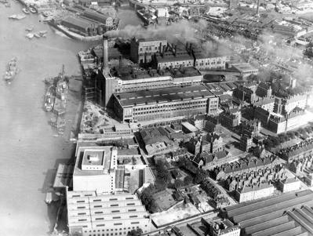
The Charming 19.Century ____________________________________________________________________________________________
median rate
CSEEC has invited bids to be tendered for how the power station might be constructed. Among the bidders, Broadwick Machine Works represented by Mr. Charles Broadwick and Mr. Sebastian Ferranti of Deptford Power Station were considered to be most probable winners.
But, as Mr. Broadwick mentioned, every commercial body wishing to turn St Paul's Wharfside into a generating plant was paying Knightly
Statistics: 5
Dynamite and a Woman, Ripper Street
Notes:
Probability distribution and uncertainty and risk – this topic will be reconsidered soon

Slide 4
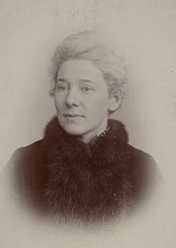
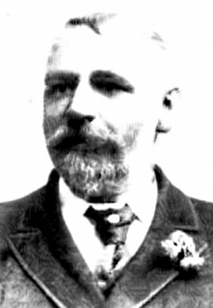
The Charming 19.Century ____________________________________________________________________________________________
median rate
In conversations with Councillor Ms. Jane Cobden and DI Edmund Reid of H-Division (Metropolitan Police), both Broadwick and Ferranti confessed to bribe MP Knightly.
Accused of bribery, Mr. Broadwick said that the only secret DI Reid would discover from him was whether he had been paying above or below the Knightly’s median rate.
Statistics: 5
Dynamite and a Woman, Ripper Street
Notes:
Probability distribution and uncertainty and risk – this topic will be reconsidered soon

Slide 5
The Charming 19.Century ____________________________________________________________________________________________
median rate
PROBLEM:
using your statistical skills decide whether or not median was an appropriate measure to approximate the bribe level necessary to not be ignored by MP Knightly.
Statistics: 5
Dynamite and a Woman, Ripper Street
Notes:
Probability distribution and uncertainty and risk – this topic will be reconsidered soon

