Slide 1
Jacek Wallusch _________________________________ PhD Programme at Gdansk Tech
Statistics and Econometrics:
Introduction

Slide 2
Introduction ____________________________________________________________________________________________
My Experience
Business:
senior data scientist at Schneider Electric
area of expertise:
quantitative pricing
Science:
Poznań, Tübingen, Hohenheim
area of expertise:
theory of money, cliometrics
Sport:
football
head coach, defensive co-ordinator
(Team Europe, Polish and Czech leagues,
European Cups)
area of expertise:
quantitative scouting
Freelance Consultant:
European Commission
International Labour Office
Statistics & Econometrics
http://www.wallusch-datenbank.de/phdgd.html

Slide 3
Introduction ____________________________________________________________________________________________
Outline and Planning
Friday: 4.15 p.m. – 9 p.m.
[1] descriptive statistics
4.15-6.30 (135 minutes)
[2] outlier detection
6.30-8.00 (90 minutes)
[3] hypothesis testing: single-sample
8.00-9.00 (60 minutes)
Saturday: 9.15 a.m. – 2 p.m.
[4] hypothesis testing: two-sample
9.15-10.15 (60 minutes)
[5] hypothesis testing: ANOVA
10.15-11.00 (45 minutes)
[6] linear regression: elasticities, goodness-of-fit, diagnostics
11.00-14.00 (180 minutes)
Statistics & Econometrics
http://www.wallusch-datenbank.de/phdgd.html

Slide 4
Introduction ____________________________________________________________________________________________
Outline and Planning
Sunday: 9.15 a.m. – 2 p.m.
[7] panel data regression
9.15-10.15 (60 minutes)
[8] time-series analysis: stationarity
10.15-11.00 (45 minutes)
[9] time-series analysis: Granger causality
11.00-12.00 (60 minutes)
[10] time-series analysis: Vector Autoregression, impulse-response, variance decomposition
12.00-14.00 (120 minutes)
Statistics & Econometrics
http://www.wallusch-datenbank.de/phdgd.html

Slide 5
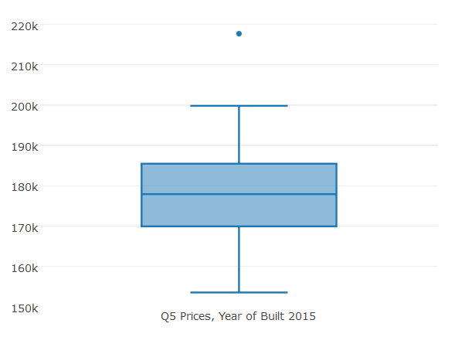
Distribution ____________________________________________________________________________________________
Boxplot
possible outlier
upper whisker (highest value)
upper quartile (75%)
median (50%)
lower quartile (25%)
lower whisker (lowest value)
Example: Statistics
Boxplot aka Box-and-Whisker

Slide 6
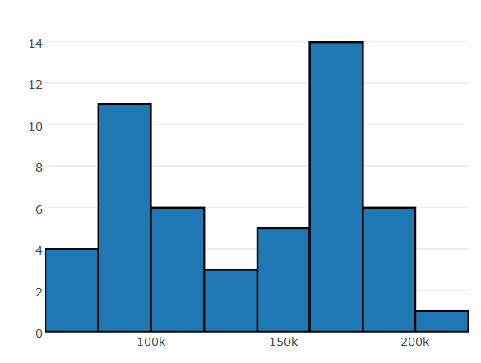
Distribution ____________________________________________________________________________________________
Histogram
multi-modal distribution
(bi-modal)
frequency of occurence
bins (price clusters)
Example: Statistics

Slide 7
Detecting Outliers ____________________________________________________________________________________________
MAD-Based Procedure
Median Absolute Deviation:
median of the absolute deviation from median
$$M\left(p\right)=m\left(\left|p_{i}−m\left(p\right)\right|\right)$$
MAD-Based Procedure:
$$O_{i}=\frac{0.6745\left[p_{i}−m\left(p\right)\right]}{M\left(p\right)}$$
Example: Statistics
More details: Iglewicz and Hoaglin (1993)

