Slide 1
Jacek Wallusch _________________________________ Quantitative Pricing Analytics
Block 1:
Pricing: A Theoretical Introduction

Slide 2
B2B ____________________________________________________________________________________________
some characteristics
Destinctive Features
bidding situations: winner-takes-all
large(r than in B2C) custom persistance
lower-than-average pricing does not guarantee a win
large impact of seasonality...
...and stock
Pricing: 1
see Bodea and Ferguson (2012)

Slide 3
Price, Revenue, and Profit ____________________________________________________________________________________________
profit levers
The illusion of nominal values:
increase | 10%
decrease | 10%
 |  | change in:
 |  | price | var.cost | sales vol.
price | £100 | £110 | £100 | £100
variable (unit) cost | £40 | £40 | £36 | £44
sales volume | 10 000 | 10 000 | 10 000 | 11 000
fixed cost | £150 000 | £150 000 | £150 000 | £150 000
revenue | £1 000 000 | £1 100 000 | £1 000 000 | £1 100 000
total cost | £550 000 | £550 000 | £510 000 | £590 000
profit | £450 000 | £550 000 | £490 000 | £510 000
profit increase |  | 22% | 9% | 13%
Pricing: 1

Slide 4
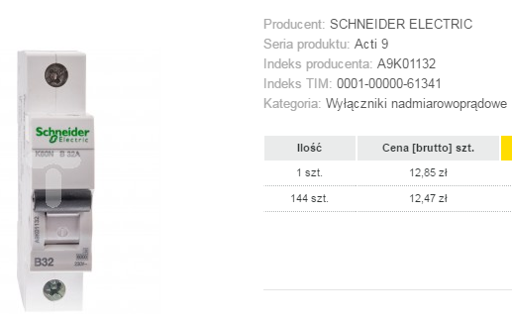
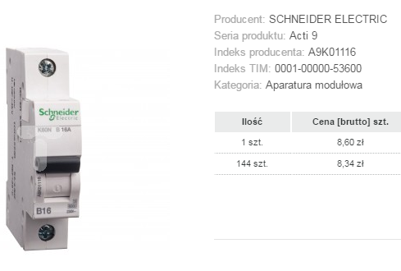
List Price ____________________________________________________________________________________________
positioning
Positioning
external
(against competitors)
internal
Pricing: 1

Slide 5
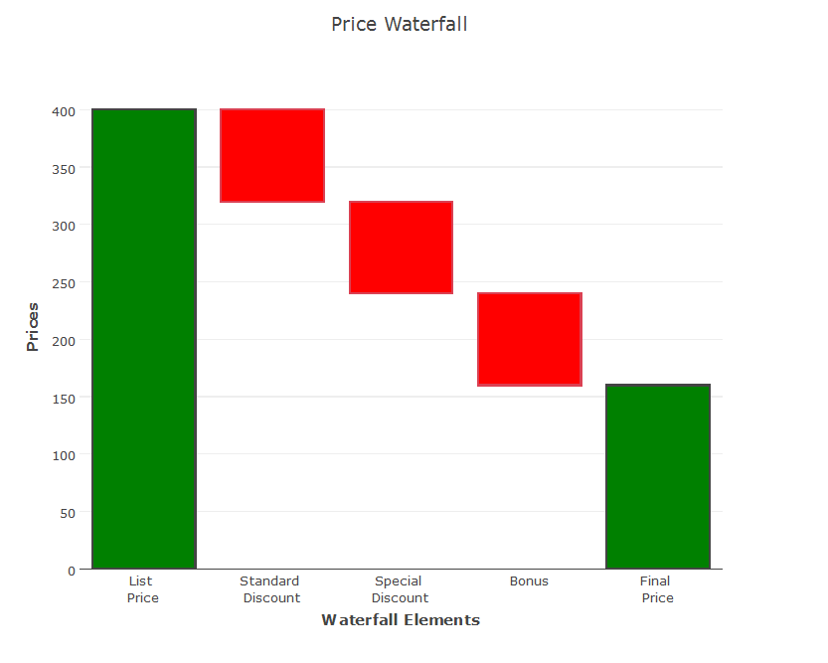
Discounting Policy ____________________________________________________________________________________________
price waterfall
Price Waterfall
various discount, rebates, and bonuses
What explains
the Waterfall
actual sales volume
potential sales volume
lifitime cycle
competition
... and more
Pricing: 1

Slide 6
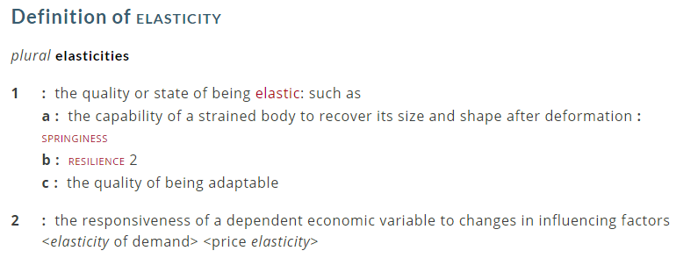
Elasticity ____________________________________________________________________________________________
definitions
(In)Formal definitions
Pricing: 1
Merriam-Webster

Slide 7
Elasticity ____________________________________________________________________________________________
non-linearities
(more) Formal definition
negative relationship between prices and quantities
Figure: Price elasticity of demand
$$\frac{dQ}{dP}=\text{– }π$$
Q =– $πP$
prices
elasticity as a marginal effect or first derivative:
$$\frac{dQ}{dP}=\text{– }π$$
quantities
Pricing: 1
Formal definition: $\frac{dQ}{dP}×\frac{P}{Q}$

Slide 8
Elasticity ____________________________________________________________________________________________
formal inquires
(1) Historical Data
multiple regression, correlation
next parts:
OLS, count data, binary and ordinal choice models
(2) Experiments
e.g. changes in sales volume attributed to temporary changes in price
(3) Useless theoretical concept
Pricing: 1
Experimental data fast become historical data

Slide 9
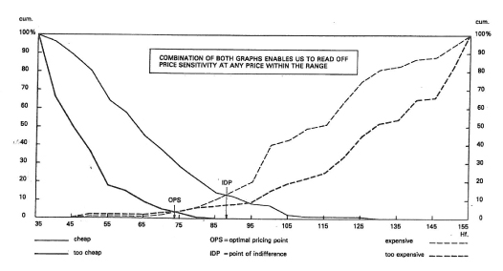
Experiments ____________________________________________________________________________________________
van Westendorp’s PSM
Price Sensitivity Meter
Peter van Westendorp (1976), NSS-Price Sensitivity Meter (PSM) – A New Approach to Study Consumer Perception of Price, Proceedings of the ESOMAR Congress.
The Intersections:
[1] too cheap & too expensive: OPS
[2] cheap & expensive: IDP
[3] too cheap & not cheap and too expensive & not expensive: range of acceptable price
Pricing: 1
https://rwconnect.esomar.org/a-new-approach-to-study-consumer-perception-of-price/

Slide 10
Value Map ____________________________________________________________________________________________
performance
Relative Performance vs. Price
Features | A | B | ... | F
F1 | 20 | 95 | ... | 75
F2
F3
F4
⁞
Fk
45°
price
B
A
C
E
F
D
marks: 0-to-1 interval (percentages)
relative performance
Pricing: 1
Reinecke, Mühlmeier, Fischer (2009)

Slide 11
Rigidities ____________________________________________________________________________________________
mark-up
The Mark-Up Approach to Pricing
AKA Cost-Plus Pricing:
price = total unit cost + expected mark-up
Dolan and Simon on Cost-Plus
In practice, one of the most popular setting methods is “cost-plus pricing”, wherein unit costs were determined and a mark-up is applied to yield price
Dolan and Simon (1996)
Pricing: 1
Recent most influential macroeconomic models of inflation and pricing: Calvo pricing, New Keynesian Phillips Curve

Slide 12
Rigidities ____________________________________________________________________________________________
inealstic prices
Nominal rigidities
prices not responding to changes in nominal demand, e.g. nominal money supply
(menu costs)
Real rigidities
prices not responding to changes in nominal demand, e.g. nominal money supply
(menu costs)
Pricing: 1

Slide 13
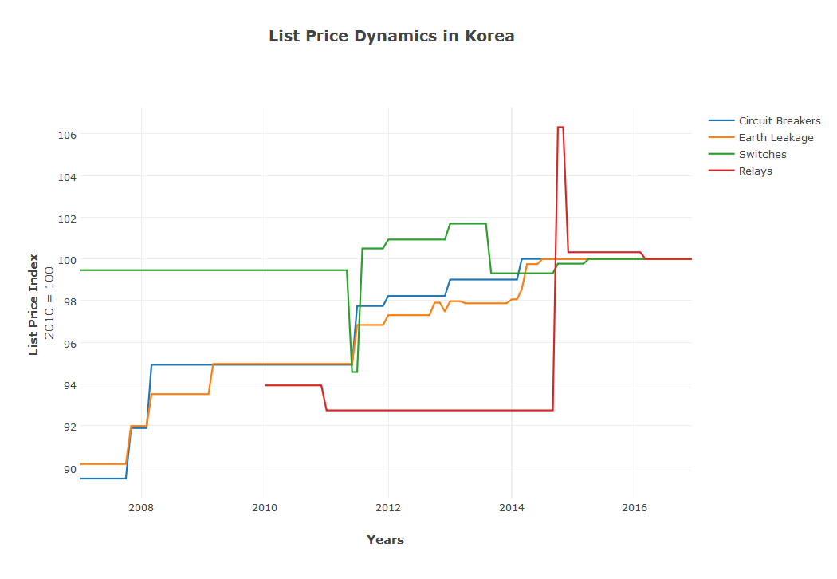
Rigidities ____________________________________________________________________________________________
an illustration
Electrical Equipment Prices in Korea
circuit breakers, earth leakage, switch, relay
ʽspurious’ rigidities
Pricing: 1
Bank of Korea
http://ecos.bok.or.kr/flex/EasySearch_e.jsp

Slide 14
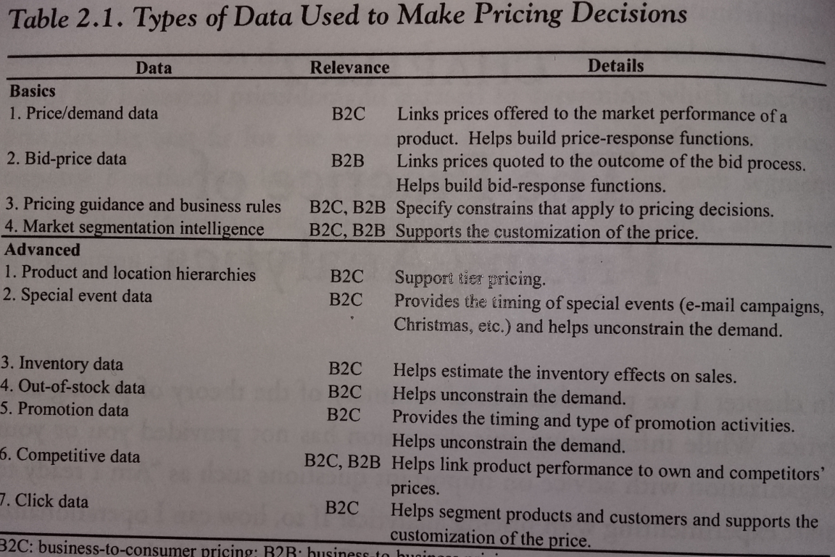
Data ____________________________________________________________________________________________
B2B vs. B2C
Between Theory and Practice:
X-Sell
WDs
CCC
Pricing: 1
Bodea and Ferguson (2012)
Tier pricing: segmentation of customers according to their willingness to pay, performer in highly heterogeneous pricing environment

Slide 15
B2B vs. B2C ____________________________________________________________________________________________
some differences
An how I perceive it:
B2B data: larger persistence, larger importance of aggregation, larger variability and volatility (channels, products*)
B2B pricing: closer to macroeconomics with solid microeconomic foundations than to B2C
Pricing: 1
* this week alone I’ve developed a web-app for
one type of wiring devices with 1000+ SKUs

