Slide 1
Jacek Wallusch _________________________________ Applied Quantitative Methods for Business Development and Analysis
Lecture 5:
Ordinal Choice Models
with a guide to ordinal-package

Slide 2
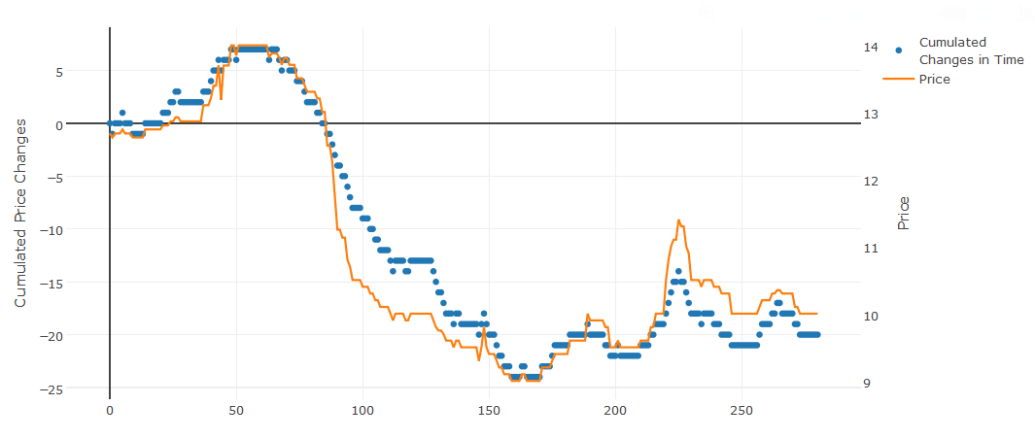
Introduction ____________________________________________________________________________________________
Data
Ordinal:
>>of a specified order or rank in series<<
Examples:
price development (decrease, no changes, increase)
discount clusters (e.g. below 5%, 5%-10%, 10%-15%, more than 15%)
rating (e.g. number of stars in the IMDB)
Price Development:
AQM: 5
Webster’s Dictionary

Slide 3
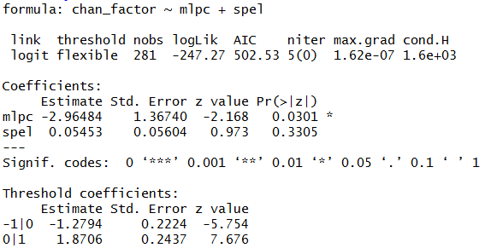
clm Function ____________________________________________________________________________________________
Estimation
clm(): function
write the left-hand variable as factor
AQM: 5
link specifies the type of model
summary() to get the estimated coefficients
2 estimated cut-off terms for 3 states (decrease, no changes, increase)
Package: ordinal

Slide 4
Cumulative Probabilities ____________________________________________________________________________________________
Inference
Probabilities:
General formula for j = 1, 2, …, M – 1
More specifically
$$\text{Prob}\left(p_{i}>j\right)=\frac{exp⁡\left(X_{i}β−λ_{j}\right)}{1+\exp\left(X_{i}β−λ_{j}\right) }$$
$$\text{Prob}\left(p_{i}=1\right)=1−\frac{exp⁡\left(X_{i}β−λ_{1}\right)}{1+\exp\left(X_{i}β−λ_{1}\right) }$$
$$\text{Prob}\left(p_{i}=j\right)=\frac{exp⁡\left(X_{i}β−λ_{j−1}\right)}{1+\exp\left(X_{i}β−λ_{j−1}\right) }−\frac{exp⁡\left(X_{i}β−λ_{j}\right)}{1+\exp\left(X_{i}β−λ_{j}\right) }$$
$$\text{Prob}\left(p_{i}=M\right)=1−\frac{exp⁡\left(X_{i}β−λ_{M−1}\right)}{1+\exp\left(X_{i}β−λ_{M−1}\right) }$$
AQM: 5

Slide 5
Cumulative Probabilities ____________________________________________________________________________________________
Example
Probabilities:
Value at averages
Probability of decreasing price (at averages)
Probability of not changing price (at averages)
Probability of increasing price (at averages)
$X_{i}β=−2.965∙avg\left(mlpc\right)+0.054∙avg\left(spel\right)$ = – 8.395
$\text{Prob}\left(chan=−1\right)=1−\frac{\exp\left(\text{– 8.395}\text{+1.279}\right)}{1+\exp\left(\text{– 8.395}\text{+1.279}\right) }=$ 0.999189
$\text{Prob}\left(chan=0\right)=\frac{exp⁡\left(\text{– 8.395+1.279}\right)}{1+\exp\left(\text{– 8.395+1.279}\right) }−\frac{\exp\left(\text{–8.395} \text{–}\text{ 1}\text{.}\text{871}\right)}{1+\exp\left(\text{–8.395 – 1.871}\right) }=0.000776$
$$\text{Prob}\left(chan=1\right)=1−\frac{\exp\left(\text{–8.395} \text{–}\text{ 1}\text{.}\text{871}\right)}{1+\exp\left(\text{–8.395 – 1.871}\right) }=0.000035$$
AQM: 5

Slide 6
Results ____________________________________________________________________________________________
Team work
Task:
present the estimation results
(hint: you can use simulation results, actual values,
graphs, tables)
Extra Point:
2-point conversion
AQM: 5

