Slide 1
Jacek Wallusch _________________________________ Applied Quantitative Methods for Business Development and Analysis
Lecture 4:
Introduction to R:
Graphs

Slide 2
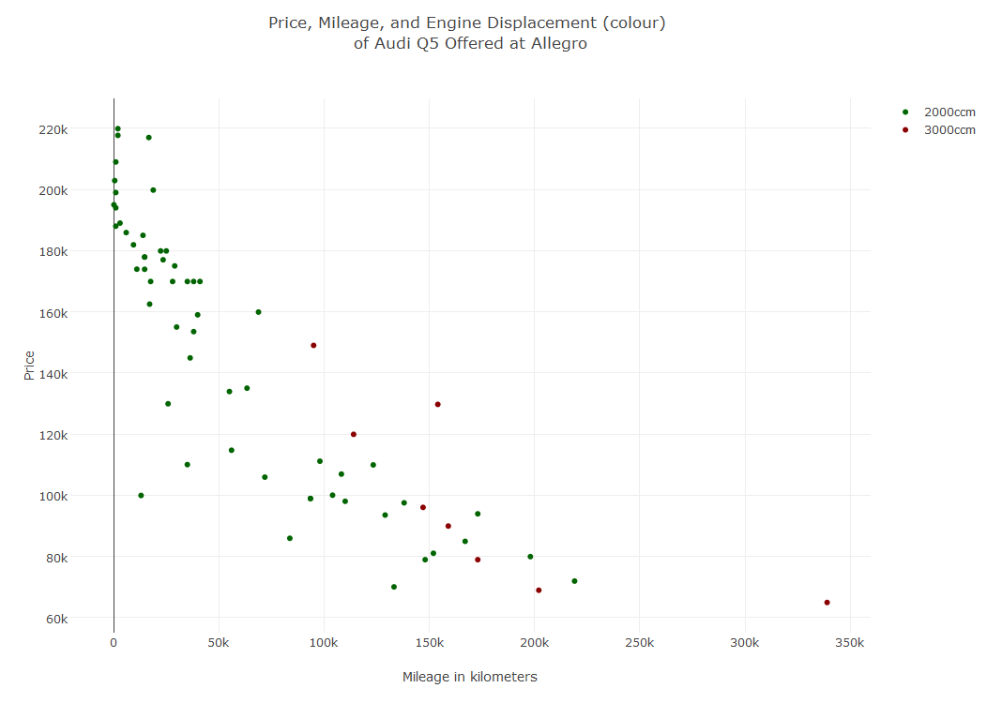
Colour Grouping ____________________________________________________________________________________________
‘color ‘ and ‘colors’
List the colours:
[1] remember to define the colours as group c("colour1", "colour2")
Grouping:
Variable of interest grouped by
another variable (condition)
Colour Selection
Define colours
Axes description within list()-environment
AQM: 4
Use plot_ly

Slide 3
Residuals ____________________________________________________________________________________________
Theory and Practice
Create a normal distribution for
hist$mid
hist(variable)$density: creates a vector of y-axis values
hist(variable)$mid: creates a vector of x-axis values
Mid: mid-value of a bin
Density: density associated to the mid-value
AQM: 4

