Slide 1
Jacek Wallusch _________________________________ Applied Quantitative Methods for Business Development and Analysis
Lecture 4:
Introduction to R:
Multiple Linear Regression

Slide 2
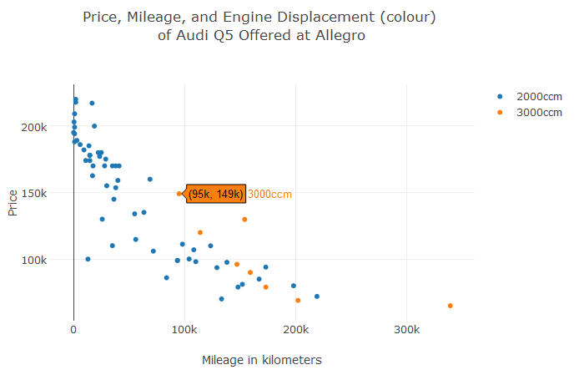
Introduction ____________________________________________________________________________________________
Data
Main Problem: Audi Q5 Prices
Intuition behind the experiment: there should be relationship between
vehicle’s engine displacement (in cubic capacity),
vehicle’s age (in years),
vehicle’s mileage (in kilometers)
vehicle’s drivetrain
and vehicle’s price
Visualisation
R-Code: lines 39-46
AQM: 4
Use plot_ly

Slide 3
lm Function ____________________________________________________________________________________________
Estimation
lm(): function (linear model)
dependent
(explaining)
variable
independent
(explanatory)
variables
summary(): table
summarising the results
AQM: 4

Slide 4
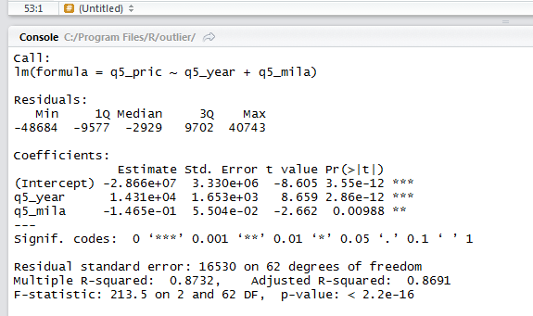
lm Function ____________________________________________________________________________________________
Significance
Coefficients’ p-values
Coefficients’ values
Overall F-test
AQM: 4

Slide 5
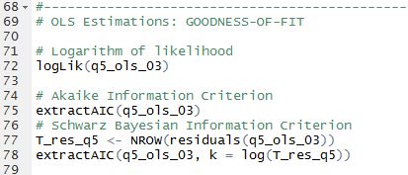
lm Function ____________________________________________________________________________________________
Goodness-of-Fit
R-squares
AQM: 4

