Slide 1
Jacek Wallusch _________________________________ Applied Quantitative Methods for Business Development and Analysis
Lecture 2:
Introduction to R

Slide 2
Introduction ____________________________________________________________________________________________
What is R?
The R project for Statistical Computing
>> R is a language and environment for statistical computing and graphics. <<
The Structure
>>R can be considered as a different implementation of S.<<
>> The S language is often the vehicle of choice for research in statistical methodology, and R provides an Open Source route to participation in that activity. <<
The R Studio
>>RStudio is an integrated development environment (IDE) for R. It includes a console, syntax-highlighting editor that supports direct code execution, as well as tools for plotting, history, debugging and workspace management. <<
AQM: 2
GNU, R, and the R Studio

Slide 3
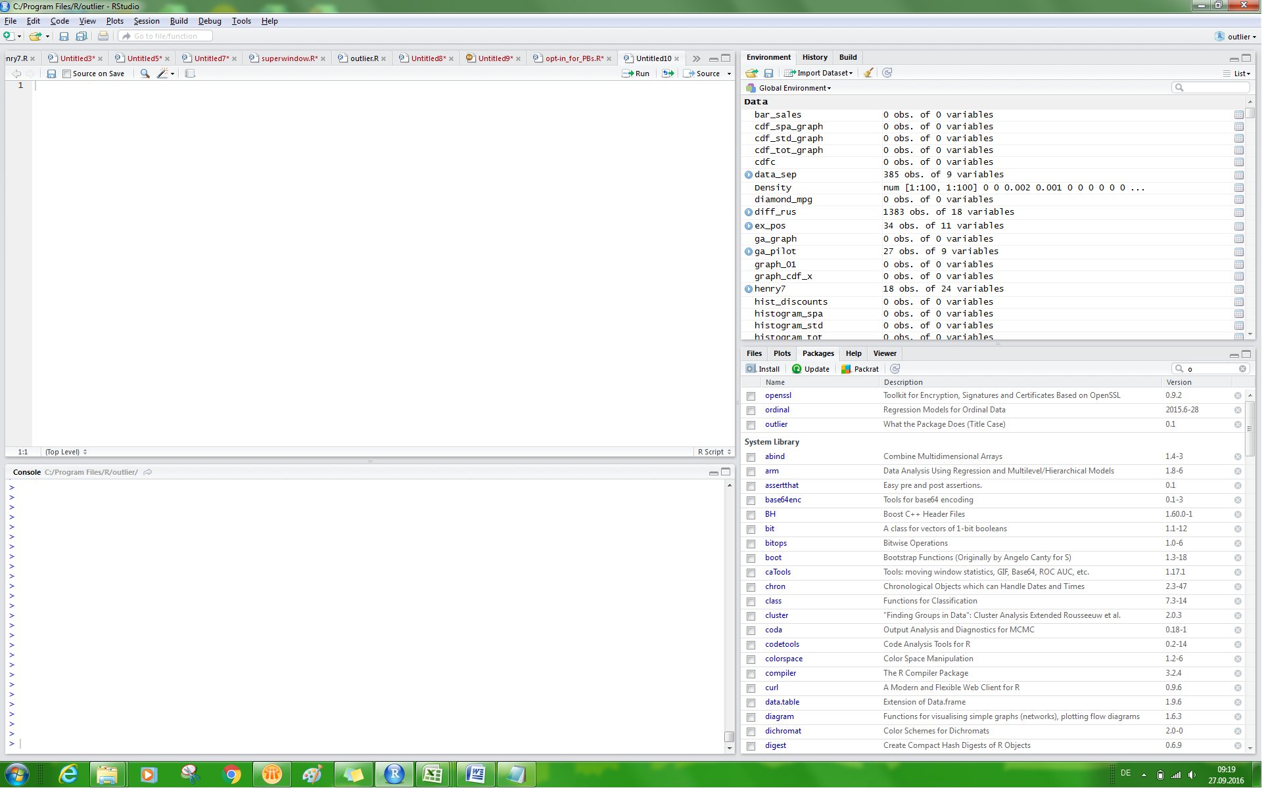
R Studio ____________________________________________________________________________________________
The Interface
TOOLS: packages
The RUN button
The SAVE buttons
NEW SCRIPT
Write your code here
The data
Console
Packages, Plot Viewer, Help
AQM: 2
The RUN button: alternatively, mark the line(s) and hit CTRL+R

Slide 4
Getting Started ____________________________________________________________________________________________
Importing Data
Data File Format
Example
import a csv-file >>my_data.csv<< located in >>C:\Users\Documents\PROJECTS<<, and name the imported data file >>example_data<<
example_data <- read.csv("C:/Users/Documents/PROJECTS/my_data.csv",
header=TRUE, sep = ";")
File Format | Command
CSV | <- read.csv("data location", header=TRUE, sep = ";")
TXT | <- read.table("data location")
AQM: 2
Warning: make sure the address is re-written

Slide 5
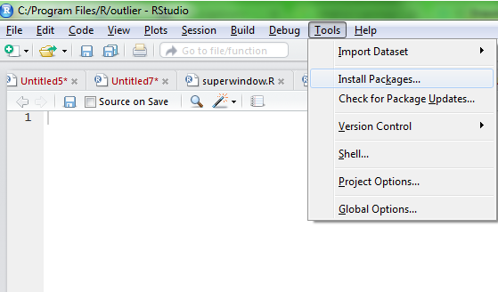
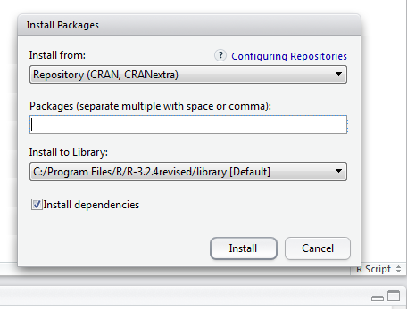
Getting Started ____________________________________________________________________________________________
Downloading Packages
R Package
>>Packages are collections of R functions, data, and compiled code in a well-defined format.<<
Library
>>The directory where packages are stored is called the library.<<
AQM: 2
http://www.r-tutor.com/r-introduction/data-frame/data-import

Slide 6
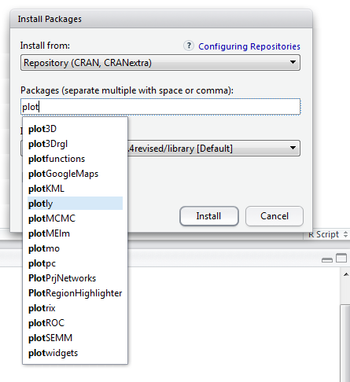
Getting Started ____________________________________________________________________________________________
Downloading Packages
Example
Download package PLOTLY
type the name of the package you would like to install
select the package from the list
click INSTALL
AQM: 2

Slide 7
Descriptive Statistics ____________________________________________________________________________________________
Example
AQM: 2
Skewness and Kurtosis: use also the psych-package

Slide 8
Time Series ____________________________________________________________________________________________
The ZOO-Package
R and Time Series
[1] Make sure the variable has a time series interpretation.
[2] Make sure the vector of dates can be recognised by R
[3] Apply the zoo-package
Dates
[1] Daily series: preferred format saved in .csv-file
YYYY-MM-DD
[2] For monthly and quarterly data use
as.Date
Zoo-Object
Assign the dates to the variable (ordered observations)
AQM: 2
ts-object: an alternative time-series object

Slide 9
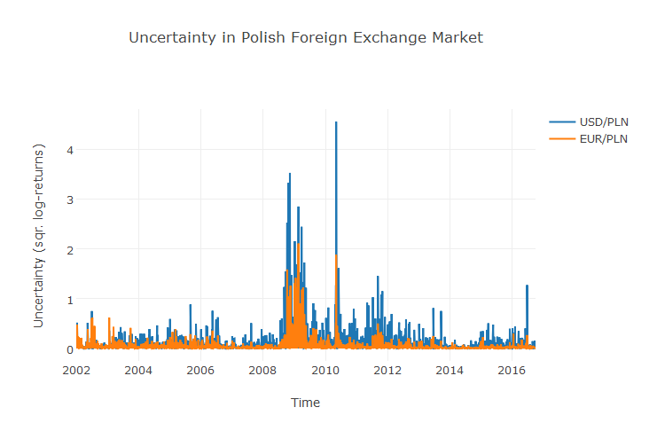
Time Series ____________________________________________________________________________________________
Example
Uncertainty in the Polish foreign exchange rate market
Squared differences of the logarithmic rate of return as an approximate measure of uncertainty
Operations
[1] take the natural logarithms of forex series
[2] calculate first differences
[3] square the first differences
AQM: 2
file: week02.R

Slide 10
Homework Assignment ____________________________________________________________________________________________
Week 2
Uncertainty in the Polish foreign exchange rate market again
[1] select two currencies: one from G7-like country and one from emerging market
[2] perform the necessary operations to get the uncertainty measure
[3] plot the uncertainty measure against time
[4] interpret and compare the results
Send the R-script
Send the presentation in Power Point
Remarks:
interpret does not mean ‘describe only’
PAT: an extra point for two more countries from the same region as the emerging country
AQM: 2
file: week02.R

