Slide 1
Jacek Wallusch
_________________________________
Applied Quantitative Methods for Business Development and Analysis
Lecture 8:
Introduction to R

Slide 2
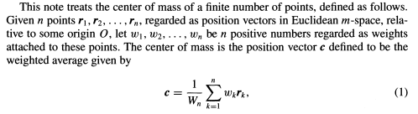
Introduction
___________________________________________________________________________________________________________________
Centroid
Centroid
location representing the centre of a cluster
recall the definition of weighted average (W_{n})
AQM: 8
T. M. Apostol and M. A. Mnatsakanian, Centroids Constructed Graphically, Mathematics Magazine, vol. 77. no. 3, June 2004

Slide 3

Introduction
___________________________________________________________________________________________________________________
Distance
Minkowski Distance
a distance of order p is defined as
$$D\left(X,Y\right)={\left(\sum_{i=1}^{T}{{\left|x_{i}−y_{i}\right|}^{p}}\right)}^{\frac{1}{p}}$$
Euclidean Distance
Minkowski distance with p = 2
Y
y_{j}
points in a Euclidean space
x_{j} X
8 xs and 8 ys
X Y
x₁, x₂, ..., x₈
y₁, y₂, ..., y₈
AQM: 8

Slide 4
k-Means
___________________________________________________________________________________________________________________
When to use it
Advantages
  computationally fast and simple
  intuitive
Problems
  not performing well in presence of outliers
  suitable for detecting spherical clusters
  number of clusters (centroids) should be pre-determined
non-spherical clusters
AQM: 8

Slide 5
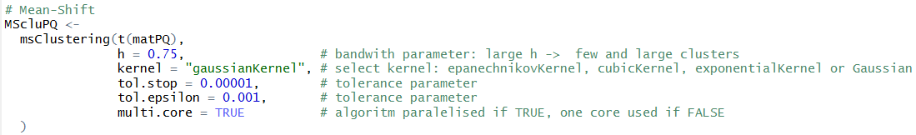
Mean-Shift
___________________________________________________________________________________________________________________
Algorithm
Procedure
  centroid-based algorithm
  converges to local centroids
  procedure seeks the modes (local maxima) of a (specified) density function
AQM: 8
HINT: Variables should be standardised before initiating the algorithm

Slide 6
Mean-Shift
___________________________________________________________________________________________________________________
Algorithm
Procedure
  select randomly a point (black dot)
  radius depending on the kernel density (grey-shaded area)
  iterative process of sliding the circular window towards a higher-density region
  iterations are terminated when convergence is achieved (no additional points are added to the kernel
  steps 1-4 are performed for numerous sliding circular windows
randomly chosen point
density
slide towards a higher-
density region
AQM: 8

Slide 7
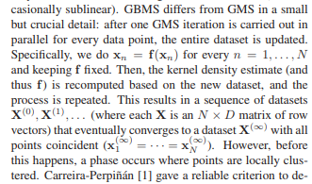
Blurring Mean-Shift
___________________________________________________________________________________________________________________
Recent Development
Advantages
  much faster than the standard mean-shift
  converges to local centroids
Problems
  asymptotic bias depending on the design of smoothing components
Procedure
AQM: 8
M. A. Carreira-Perpinan, Generalised Blurring Mean-Shift Algorithms for Nonparametric Clustering, 2008

